Slide 1
Software Engineering
Automated Parking Garage System

Slide 2
Phase 1– ERROR 404
Project : < Automated Parking Garage System >
Document Purpose and Audience
- My document is preparing to manage occupancy of parking garage, people who work in garage ,programmer of garage system , project manager and developer of this system will read this document
- My documents explains :
. How garage will work ?
. How this system helps people in garage ?
. What is requirements we will need ?
. The registration software of garage.
- The target audience to read it are project manager ,
CEO , customer , developer ,programmer and tester.

Slide 3
Phase 1– ERROR 404
Project : < Automated Parking Garage System >
Introduction
Software Purpose
to create software helps us to manage occupancy of parking garage and helps customers to find available parking places.
Software Scope
- Software garage can reserve place to customer to parking cars and provide the better way for exit pathway , these is normal things for any garage system .
- Software garage has some features as provide using elevator to access to the parking decks above the ground level and provide the occupancy monitoring by special way .
- Software allows to customer to edit/cancel their reservation an hour before their reservation time.
- Software shall back up parking data and dialy reports once a day.

Slide 4
Phase 1– ERROR 404
Project : < Automated Parking Garage System >
Definitions, acronyms, and abbreviations
- by considering the
audience ,
- elevator : compartment housed in a shaft for raising and lowering things to different floors
- license-plate reader: The reader will use a digital camera and a license-plate recognition system
- sensor :that senses the occupancy of the spot by a vehicle
- digital display : display some specific messages
- the license-plate recognition system: system used to identify inf.
Available parking places
Easy way to reserve or cancel reservations
Security for cars
Privacy for personal information
Cheaper cost for parking
Easier machines to use

Slide 5
Phase 1– ERROR 404
Project : < Automated Parking Garage System >
Requirements
Functional Requirements
1- license-plate readers
- Image which is taken by digital camera to be ready to it.
- System used the license-plate recognition system to it.
- System will read and record the vehicle reservation number by using license-plate readers
2- Sensor
- Used to senses the occupancy of the spot by a vehicle
3- Digital display
- places in elevator and at ground floor
- display various messages or information for customer
4- Customer’s data
- Providing demographic information and a valid email and his or her credit card number.
- may providing the license plate numbers for his or her vehicle(s).
- provide his /her phone numbers to reserve for an empty spot can be done when the registered customer arrives to the garage

Slide 6
Phase 1– ERROR 404
Project : < Automated Parking Garage System >
5- guaranteed reservations
-which allow customers to make a (monthly) contract with the parking garage for a parking spot
6- Update reservations
-edit/cancel their reservation an hour before their reservation time to avoid any penalty charges.
7- Administration
-allowing to manager to login into the system to view monthly reports, payroll information, and change prices for the parking garage.
- allowing to manager to view the number of reserved cars and the number of walk-ins
8- Backing UP
-System shall back up parking data and daily reports once a day, to prepare for any natural or human-induced disasters that may occur.

Slide 7
Phase 1– ERROR 404
Project : < Automated Parking Garage System >
Requirements
Non-Functional Requirements
Details | Non-Fun.
- System allow customers to find and reserve available parking places. - System uses digital display to display clear and easy messages for customers. - System uses customers’ number to inform empty spot in garage based on customers’ questions. - System support guaranteed reservations to provide basic spot for customer. - Reservation for an empty spot can be done when the registered customer arrives to the garage. | Usability
- The capacity of garage may contains 300, …. Vehicles. - The reservation can be done for 300 customers at the same time. - The system contains monthly reports, payroll information, and change prices for the parking garage. | Scalability

Slide 8
Phase 1– ERROR 404
Project : < Automated Parking Garage System >
- In our system, Parking data and daily reports shall be backed up once a day. - Reservation operation will be done within 20 seconds. | Performance
- Manager only has right to access on the customer’s data. - In our system, Parking data and daily reports shall be backed up once a day. - Customer ‘s data is necessary for reservation in garage. - Digital camera should take perfect photo to license-plate reader to can read it. - There is only one exit pathway to make garage be secure. | Security
- In our system, Parking data and daily reports shall be backed up once a day. - Saving of customers’ data as number, address , cost , etc. | Maintainability
- The company website is portable (as customer can use your mobile to reserve a spot in garage ). | Portability
- The parking garage is secure and perfect to make customer want to leave their vehicles in our garage. | Reliability

Slide 9
Phase 1– ERROR 404
Project : < Automated Parking Garage System >
Scenario
We are now trying to do a scenario analysis of a garage gate that opens and closes automatically
In this project we will use two limit switches:
It must first be known whether it is (open - closed) or (between open and closed).
On the control panel there is a lock button and an unlock button.
First case:
Garage subscription system:
In the event that the customer wanted to subscribe to a system of systems provided by the software, which are pre-agreed systems for programming them (the system of the year, the system of the half year, ....), and each system has a financial value, determined by a single person who is the garage manager for Through his own account, the software takes from each registered customer a set of data such as: name, phone number, e-mail for him, date of subscription and type of subscription. As for the expiry date, it is worryingly challenged by the type of subscription, and ID is automatically placed by placing a random number next to the phone number Of the registered customer, where the registered customer gives the ID to the software searches the database if found, the door opens automatically.

Slide 10
Phase 1– ERROR 404
Project : < Automated Parking Garage System >
Second case:
The bulb is lit green:
If a customer comes and wants to put the car in the garage, the software enters the car number, and as soon as the unlock button is pressed, the automatic timer does his job, and the customer ID is given say in range 1-300 (Scope is determined by location capacity), it will be given to the customer so that the time spent by that number is easily spent.
Third case:
The bulb is lit red:
If one of the customers wants to exit the garage, Once he gives the customer his temporary number, Software calculates the number of hours that the car has set up in the garage and by multiplying the number of hours by the one-hour residence value; the worker shows the value of the entire stay, And the ID number is released at that moment.
Fourth case:
If a customer wants to leave the garage and does not cross the half hour barrier, the system will alert and raise the time to the minimum limit (an hour)

Slide 11
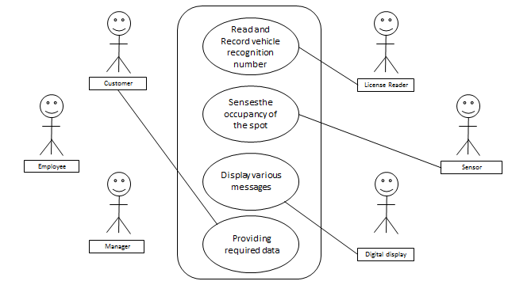
Phase 1– ERROR 404
Project : < Automated Parking Garage System >
System Models
Use Case Model

Slide 12
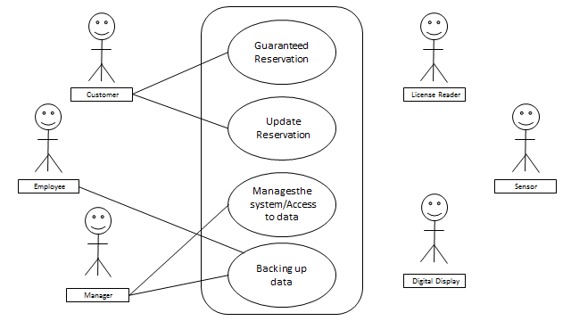
Phase 1– ERROR 404
Project : < Automated Parking Garage System >

Slide 13
Phase 1– ERROR 404
Project : < Automated Parking Garage System >
Use Case Tables
Use Case ID: | 1
Use Case Name: | License-plate reader
Actors: | License reader
Pre-conditions: | Passing vehicles through gates of garage
Post-conditions: | Read and record the vehicles reservation number
Flow of events: | User Action | System Action
 | 1-vehicles pass through enter or exit gates of garage with license
 |  | 2- digital camera take photo 3- use recognition system 4- system record vehicles
 | and so on
Exceptions: | User Action | System Action
 | 1-vehicles pass through enter or exit gates of garage without license
 |  | 2- Card is invalid and unreadable. 3- System rejects cars.
Includes: | Digital camera and license recognition system
Notes and Issues: | Required image should be clear to system

Slide 14
Phase 1– ERROR 404
Project : < Automated Parking Garage System >
Use Case Tables
Use Case ID: | 2
Use Case Name: | sensor
Actors: | sensor
Pre-conditions: | Vehicles are placed on this spot
Post-conditions: | senses the occupancy of the spot by a vehicle.
Flow of events: | User Action | System Action
 | 1-Vehicles are placed on this spot
 |  | 2- System senses of presence of vehicles
 | 3-vehicles left this spot
 |  | 4- System recognize that there are no vehicles
 | and so on
Exceptions: | User Action | System Action
 |  | 1-System rejects cars
Includes: | Sensor and recognition system
Notes and Issues: | If vehicles placed on this spot which is reserved by another one ,sensor can not differeniat between them

Slide 15
Phase 1– ERROR 404
Project : < Automated Parking Garage System >
Use Case Tables
Use Case ID: | 3
Use Case Name: | Digital display
Actors: | Digital displayer
Pre-conditions: | Vehicles used elevator or spot on ground
Post-conditions: | Display various messages about vehicles either be reserved or not
Flow of events: | User Action | System Action
 | 1- Vehicles used elevator or spot on ground.
 |  | 2- System display various messages about vehicles
 | and so on
Exceptions: | User Action | System Action
 |  | 1-System rejects cars
Includes: | Data and some information about vehicles either be reserved or not
Notes and Issues: | messages will include information for non-registered customers of a denied access to upper decks, or information for registered customers of changes in their reservation

Slide 16
Phase 1– ERROR 404
Project : < Automated Parking Garage System >
Use Case Tables
Use Case ID: | 4
Use Case Name: | Customer’s data
Actors: | customer
Pre-conditions: | System ask about data of customer
Post-conditions: | Providing all required data for system
Flow of events: | User Action | System Action
 | 1-customer enter his number and demographic information and a valid email and his or her credit card number.
 |  | 2- System Verify user data
 | and so on
Exceptions: | User Action | System Action
 | 1- User may enter his phone or not
 |  | 2- System Verify user data .
Includes: | number and demographic information and a valid email and his or her credit card number
Notes and Issues:

Slide 17
Phase 1– ERROR 404
Project : < Automated Parking Garage System >
Use Case Tables
Use Case ID: | 5
Use Case Name: | Guaranteed reservation
Actors: | customer
Pre-conditions: | Customer press on button to reserve spot
Post-conditions: | Customer guarantee spot in garage
Flow of events: | User Action | System Action
 | 1-Customer press on button to reserve spot
 |  | 2- System asked for his data and time of reservation and how many days of reservation
 | 3-Customer enter his data and ask for the required cost
 |  | 4- System display the cost and waiting confirmation
 | 5- customer may accept or reject the confirmation
Exceptions: | User Action | System Action
Includes: | Customer’s data , location of spot , time of reservation , days of reservation
Notes and Issues: | customers are desirable because they can provide predictable and steady income.

Slide 18
Phase 1– ERROR 404
Project : < Automated Parking Garage System >
Use Case Tables
Use Case ID: | 6
Use Case Name: | Up date reservation
Actors: | Customer
Pre-conditions: | Customer press on button to add or cancel reservation
Post-conditions: | customer may edit/cancel their reservation
Flow of events: | User Action | System Action
 | 1- Customer press on button
 |  | 2- System display user data and ask him to update his data
 | 3- customer may edit/cancel their reservation
 |  | 4- System display modified data and display done
 | and so on
Exceptions: | User Action | System Action
Includes: | Customer’s data , modified data
Notes and Issues: | Make the change of data be easy

Slide 19
Phase 1– ERROR 404
Project : < Automated Parking Garage System >
Use Case Tables
Use Case ID: | 7
Use Case Name: | administration
Actors: | manager
Pre-conditions: | Manager login in to system
Post-conditions: | Manager access to all data , prices , reports, payroll information
Flow of events: | User Action | System Action
 | 1-Manager login.
 |  | 2- System display all icons of accessible data
 | 3- manager choose required icon
 |  | 4- System display all data
 | and so on
Exceptions: | User Action | System Action
 | 1-Manager enter wrong password or user name
 |  | 2-system will display invalid data
Includes: | all data of customers and vehicles , prices , reports, payroll information
Notes and Issues: | Manager is the only one has right for access to all data in system

Slide 20
Phase 1– ERROR 404
Project : < Automated Parking Garage System >
Use Case Tables
Use Case ID: | 8
Use Case Name: | Backing up
Actors: | Employee , manager
Pre-conditions: | Log in to backing up system
Post-conditions: | Parking data and daily reports shall be backed up once a day
Flow of events: | User Action | System Action
 | 1- User log in system .
 |  | 2- System display back up icon
 | 3- User select data that should be back up
 |  | 4- System back up the required data
 | and so on
Exceptions: | User Action | System Action
 | 1-Manager enter wrong password or user name
 |  | 2-system will display invalid data
Includes: | Parking data and daily reports
Notes and Issues: | to prepare for any natural or human-induced disasters that may occur.

Slide 21
Ownership Report
Owner | Item
 | Non-Functional Requirements/UseCase table
 | Functional Requirements/UseCase table
 | Scenario
 | Introduction and Usecase model

